Slide 1
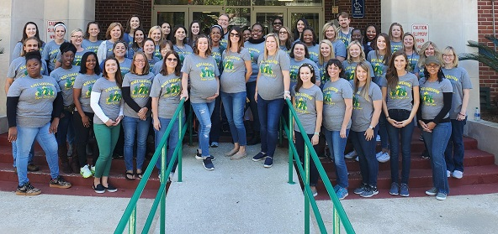

Title Layout
Kate Sullivan Elementary
Home of the Crocs
2021 - 2022
Subtitle

Slide 2
Welcome to Kate Sullivan Elementary
Dear “New” Crocodile Parents:
We are excited to have you joining our awesome Crocodile Family. Our Kindergarten Team of teachers is second to none and they are already making plans for the 2021-22 school year. While the details are still being worked out, we are all excited about what the new school year will bring. Please know that our faculty, staff, and administrators are committed to making student safety and success our top priority. Please reach out to us through email or by phone if we can be of any assistance.
We look forward to seeing you soon!
Michael W. Bryan, Principal

Slide 3
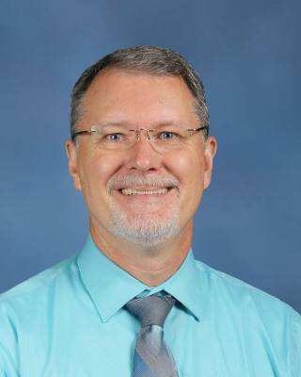
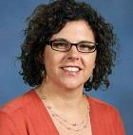
Kate Sullivan Elementary School
People you need to know
Mr. Michael Bryan
Principal
Bryanm@leonschools.net
Ms. Brooks Sperling
Assistant Principal
Sperlingb@leonschools.net
Ms. Kirsten Dazevedo
Registrar
Dazevedok@leonschools.net
Kate Sullivan Elementary School 927 Miccosukee Road, Tallahassee, Florida 32308
Phone: (850) 487-1216 Fax: (850) 487-0005 Website: http://www.leonschools.net/Sullivan

Slide 4
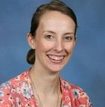
Meet The Kindergarten Teachers At
Kate Sullivan Elementary
Mrs. Ashley Allbritton
Allbrittona2@leonschools.net
Mrs. Haley Chandronnet
Chandronneth@leonschools.net

Slide 5
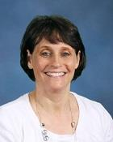
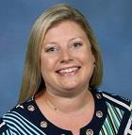
Meet The Kindergarten Teachers At
Kate Sullivan
Mrs. Dottie Schaffner
SchaffnerD@leonschools.net
Mrs. Katherine Smith
Smithk6@leonschools.net
Ms. Haley Williams- Team Leader
Williamsh2@leonschools.net

Slide 6
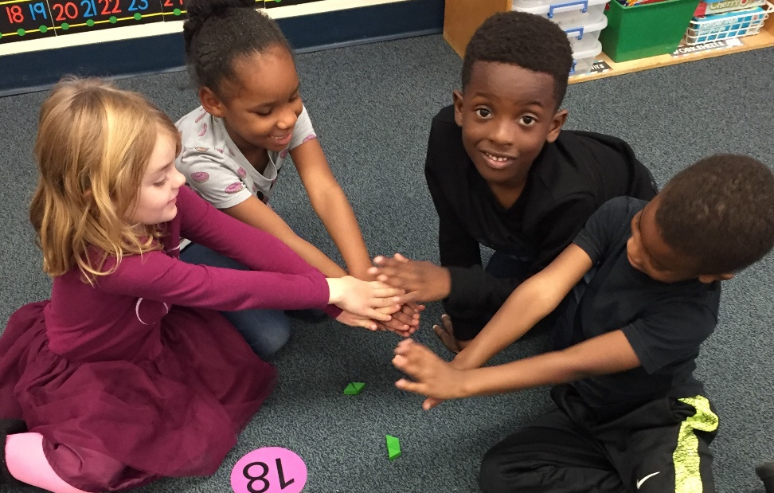
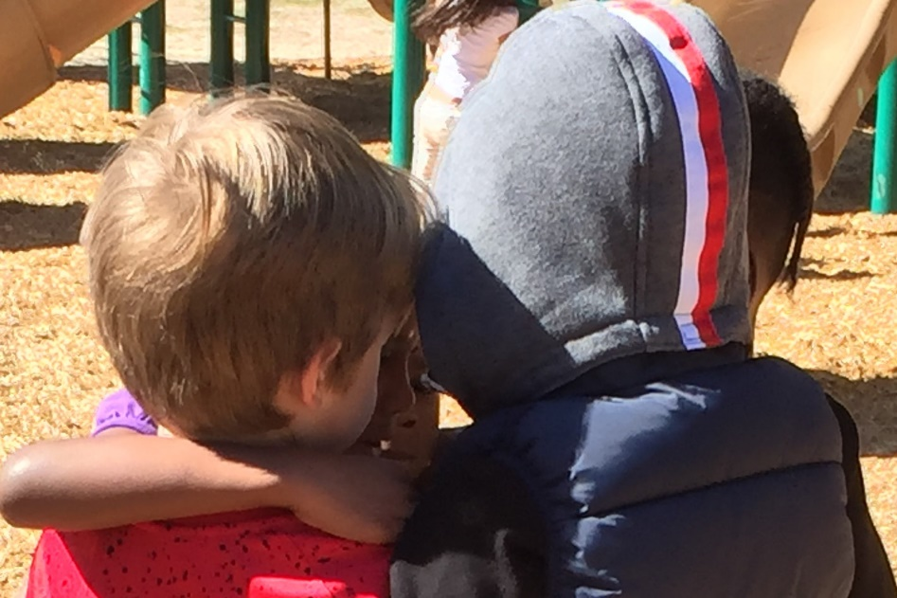

Learning, sharing, caring and building friendships

Slide 7
Is My Child Ready for Kindergarten?
Children must be five years of age on or before September 1st to begin kindergarten.
Can my child be alone in a strange place outside the home without crying or being overly fearful?
Can my child keep his/her attention on a task long enough to complete the task?
Does my child willingly participate in group activities?
Is my child respectful and responsive to adults and peers?
Can my child stay with a group when moving from one spot to another?
Can my child respond to questions? Can he/she share previous experiences?
Can my child listen to stories in a group setting?
Can my child willingly engage in art, music, and athletic activities within a classroom setting or outside the classroom with a different adult?

Slide 8
How To Prepare Your Child For School?
Teach your child his/her full name, parent’s name, address, & phone number
Teach your child to take care of his/her personal needs independently.
1. Fastening clothes
2. Toileting
3. Tying shoelaces
4. Expressing physical needs: thirst, hunger, illness, etc.
Establish a regular pattern for sleep; 10 -12 hours is recommended for most 5 year old children.
Give your child duties at home to foster self-confidence & responsibility.
1. Putting away toys
2. Setting the table
3. Caring for pets
Provide your child opportunities to interact with same-age peers. Teach them to share, take turns, play fair and how to lose gracefully.
Discourage “baby talk” and model appropriate speech.
Teach your child to look forward to attending school and that it is a happy, safe, and friendly place.

Slide 9
What your child should be able to do before Kindergarten!
Social/Emotional Development
Encourage your child to persist in tasks when encountering a problem by
giving him tasks slightly above his/her ability level.
When your child cannot find a solution on his/her own, encourage him/her to calmly ask for help.
Play board games to practice taking turns.
Set up several play dates with friends of various ages.
Language Development
Verbally give your child specific one-step and two-step directions and encourage him/her to follow through.
Read daily to your child for 15-20 minutes.
While reading, point out how to hold a book and the orientation in which we read the words and look at the pictures.
After reading, ask your child what happened in the beginning, middle, and end of the story.
Give your child opportunities to draw and write.
Expose your child to uppercase and lowercase letters of the alphabet and how they are written.

Slide 10
What your child should be able to do before Kindergarten!
Cognitive Development
Have your child help you sort items according to color, size, and shape.
(laundry, blocks, silverware, toys)
Teach your child to make color patterns. (red, blue, red, blue)
Practice counting aloud to 20.
Expose your child to numbers 0-10 and how they are written.
Teach your child to point and count objects in your home.
Go on a shape hunt. Point out circles, triangles, squares, and rectangles to your child while you are on a walk or grocery shopping.
Physical Development - Gross and Fine Motor Skills
Give your child plenty of opportunities for outdoor play: running, jumping, skipping, and climbing.
Stack blocks together.
Using child-safe scissors teach your child to cut paper and progress to cut out shapes.
Teach your child to write his/her name using a capital for the first letter and lowercase for remaining letters.

Slide 11
What your child should be able to do before Kindergarten!
Continued Physical Development – Gross and Fine Motor Skills
To begin teaching your child how to write his/her name use a highlighter and encourage him/her to trace over the letters. Be sure that he/she forms the letters from top to the bottom.
Ensure your child is holding his/her pencil correctly.
Play with play dough regularly roll, squish, stamp, pat, and cut.
Practice stringing beads together on a string or pipe cleaner.
Play with interlocking puzzles together.
Being Independent and Responsible
Teach your child how to put on a jacket and hang up their jacket.
Teach them to button, zip, snap, and practice buckling and unbuckling pants and belts.
Teach your child how use to use the bathroom. How to use the proper amount of toilet paper, flushing, and the practice of good hygiene.
Teach your child how to wash their hands and to use the proper amount of paper towels.
Teach your child how to blow their nose and cover their mouth when coughing.
Teach your child how to tie their shoes.

Slide 12

2021-2022 School Supply List
1 Pair of Headphones - Please label with Child’s name.
3 Boxes of Crayola Crayons – 24 count
1 plastic school tool box
12 Glue Sticks
1 Pack of thick Washable Markers – 8 count
1 Pack thin Expo Markers
1 Pack of No. 2 Pencils – 12 count
1 Pair of Fiskar Kids blunt scissors
Full sized backpack
Change of clothes
Refillable water bottle

Slide 13
“Parent Support”
Set aside time each day to read with your child.
We will have weekly homework starting in September. Your child’s teacher may send home paper copies or activities through Remind.
Daily folders are used to help organize your child’s work, for communication from school and from home, and provide learning tools for your child. These folders promote responsibility, prompt organization skills, and connect Parents with Teachers.

Slide 14
“Grading”
Students will receive grades in behavior and work study only for first nine weeks on the report card.
Academic grades will start in the second nine weeks.
Students will be graded by:
1. Work 2. Test 3. Participation
4. Behavior
5. Work Study

Slide 15
“A day in Kindergarten”
8:35-10:30 Language Arts
10:35-11:20 Special Area
11:30-12:00 Snack/Recess
12:00-1:00 Math/Calendar Math
1:05-1:35 Lunch (times may vary)
1:45-2:15 Social Studies/Science
2:15-2:30 Wrap-up the day and Centers
2:30-2:40 Prepare for Dismissal
2:40-2:50 Move to Dismissal Areas

Slide 16
“A day in Kindergarten”
What time does school start and end?
Supervision, and doors open at 7:45 a.m.
Breakfast begins at 8:00 a.m.
School begins at 8:25 a.m. and ends at 2:50 p.m.

Slide 17
“A day in Kindergarten”
What does my child need to bring to school everyday?
  Backpack, Daily Folder, easy to eat healthy snack and a lunch if they
  are not eating the cafeteria lunch.
  What are the Special Areas at school and when do they occur?
  Your child will attend one Special Area class each day:
  Art, PE1, Music, Media, PE2, Guidance – A rotation schedule
  will be sent home by your child’s teacher.

Slide 18

“Kindergarten Registration”
Visit KSE website https://leonschools.net/sullivan look for this
Step 1 – Complete the new student on-line registration
Step 2 – Please email the required documentation listed below to complete your child’s enrollment process.
2 Proofs of Address (one from each category)
Category 1- Current lease/rental agreement, mortgage statement, property tax
Category 2 - Current Utility bill, vehicle registration, homeowner’s/rental insurance

Slide 19
Additional required documents
* Birth Certificate
* Florida immunization Records (Form 860)
* Current physical exam
* Driver’s License (identification purposes only)
Custody/Guardian Court Documentation(if applicable)
Affidavit of Residency (if applicable)
Current or returning LCS Students:
If you have moved into our zone, or have been approved for reassignment please provide 2 proofs of address. Check in Focus to confirm the emergency contact information is correct.

Slide 20

Sign up for the KSE Listserv
Stay informed with the latest news at our school by email.
Joining is very easy!
Go to https.www.leonschools.net/Sullivan
2) Click on listserv icon at the to of the page to receive emails and announcements from our principal.
3) Put your name and email address in the boxes and click on “subscribe” on right side of the page.
4) To confirm your identity and prevent third parties from subscribing you a list against your will, and email message with a confirmation code will be sent to the address you specify on the form. Simply wait for this message to arrive, then follow the instructions to confirm the operation.

Slide 21
We hope you have a safe and restful summer and we look forward to seeing you soon!

